Slide 1
INTRODUCTION TO LANGUAGE AND LINGUISTICS

Slide 2
What is Language ?
Language is basically speech, not writing
  Most languages lack a written form
  but all human groups have a spoken language
  Many people are illiterate
  but all normal humans can speak and understand
  Writing develops later than speech (if at all)
  for cultures as well as individuals
Language is part of culture
Language is also intertwined with human biology

Slide 3
Human language is different from animal communication
  Speech organs designed for eating breathing AND speech
  Humans also geared for speech perception

Slide 4
Language Definitions
A HUMAN ACTIVITY
ARBITRARY MEANING-MAKING SYSTEM

Slide 5
A Human ACTIVITY
Sapir (1921) stated, “Language is a purely human and non-instinctive method of communicating ideas, emotions, and desires by means of a system of voluntarily produced symbols” (p. 3)

Slide 6
This means language is a creative (non instinctual) human action and a heritage of human societies.
The voluntary action results from a human desire to put thoughts into words.
Imagine, you are wondering if your friend is available to join you for dinner on the weekend and you send a text message, “Hey, what are your plans for the weekend?”
Your choice of words in this case are not pre-programmed but purposeful and creative to find out whether your friend is available.

Slide 7
ARBITRARY MEANING-MAKING SYSTEM
Halliday (2003) provides this definition, “A language is a system of meaning – a semiotic system” (p. 2)

Slide 8
While you read this, note that this system of meaning is made up of words and sounds that are given meanings by speakers.
Words do not inherently carry static meanings but, rather humans associate meanings to them.
This is called the arbitrariness of human language

Slide 9
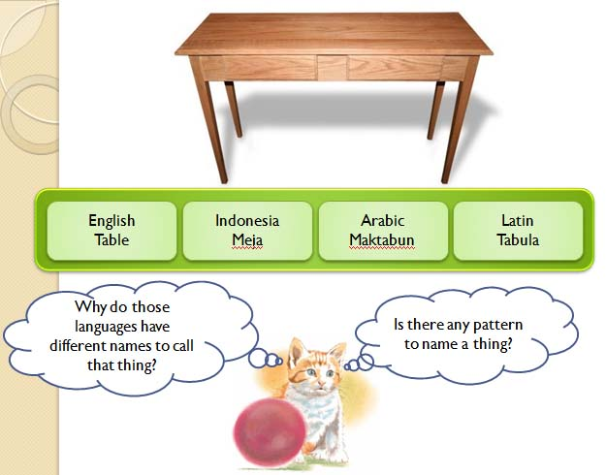

Slide 10
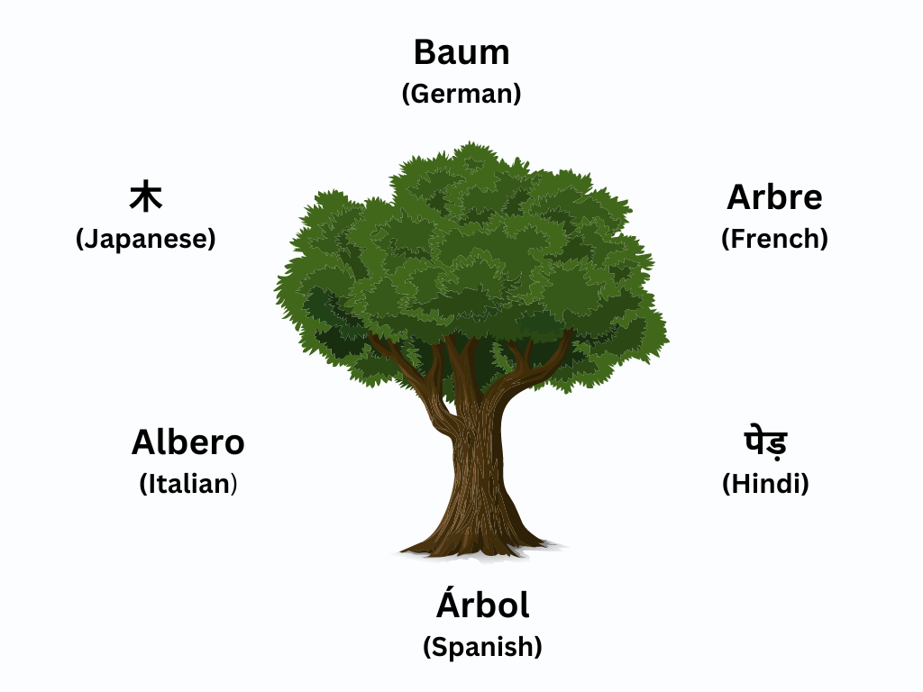

Slide 11
Functions of Language
Phatic communion
Emotive utterance
Performative utterance

Slide 12
Phatic communion
Establish or maintain social relations
How are you?

Slide 13
Emotive utterance
Expression of emotions
That’s fantastic

Slide 14
Performative utterance
An utterance is an act in itself spoken by somebody with relevant authority.
I declare the bridge open

Slide 15
Systematic Creativity in Language

Slide 16
Nouns used as verbs
The boat is on the beach The captain will beach the boat
Keep the airplane on the ground The pilot will ground the airplane
Put the wine in the bottle You will bottle the wine
Can say ”jail the robber” but not “prison the robber” because we already have the word imprison
Why limitations to creativity?
If new words constantly being made, then we wouldn’t understand each other - loss of systematicity

Slide 17
What is linguistics?
Linguistics is the scientific study of language. It encompasses all aspects of human language, seeking answers to fundamental questions about how language works (Linguistics Society of America).

Slide 18
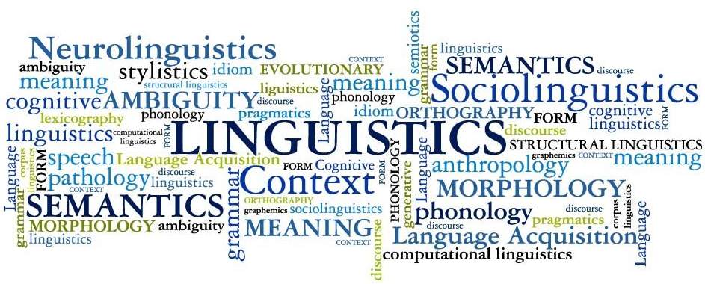

Slide 19
Micro
Macro

Slide 20
Microlinguistics ( Concern only on the language itself)
Phonology
Morphology
Syntax
Semantics
Pragmatics

Slide 21
Phonology
how speech sounds function
Morphology
how words are formed
Syntax
Semantics:
Pragmatics
how phrases, clauses, and sentences are formed
how words form meaning
how meaning is created by contexts

Slide 22
Macrolinguistics ( Apply broader views)
Psycholinguistics
Sociolinguistics
Neurolinguistics
Discourse Analysis
Computational linguistics
Historical linguistics

Slide 23
Psycholinguistics:
investigates and describes the psychological processes that make it possible for humans to master and use language
Sociolinguistics
how language use interacts with or is affected by social factors
Neurolinguistics
Discourse analysis
Computational linguistics
how and where our brains store our knowledge of the language, what happens in our brains as we acquire that knowledge, and what happens as we use it in our everyday lives
how language is used in social contexts
how computer science are applied to linguistics

Slide 24
Linguistics Competence

Slide 25
LINGUISTICS COMPETENCE
what you know about language as a native speaker
a subconscious set of rules, units, and mental constructs that enables the native speakers of a language to produce and understand an unlimited number of both familiar and novel utterances.

Slide 26
gRAMMAR
the mental system that allows human beings to form and interpret the sounds, words and sentences of their language. (all elements of linguistic competence)

Slide 27
Myths about Language
Some languages are ungrammatical
Some languages are better than others

Slide 28
All languages have grammar (generality)
If no grammar, no system and if no system, no communication and no language

Slide 29
All grammars are equal (parity)
No such thing as a primitive grammar or language
No such thing as good grammar or bad grammar

Slide 30
All grammars have things in common (Universality)
Universal traits that exists in all varieties of language
All languages can have subjects, objects and verbs, but what order they can occur in in a sentence is language specific

Slide 31
All grammars have things in common (Universality)
Universal traits that exists in all varieties of language
All languages can have subjects, objects and verbs, but what order they can occur in in a sentence is language specific

Slide 32
Grammars change over time (mutability)
Language is changing all the time

Slide 33
English Changes
Before 1200 -- Ic ne sey not (‘I don’t say’)
He ne speketh nawt (‘He doesn’t speak’)
1400 -- I seye not the wordes
We saw nawt the knyghtes.
About 1700 -- I will not say the words. (*I will say not the words.)
He did not see the knights. (*He saw not the knights.)

